Slide 1

Individual Patient Data from Clinical Trials:
An introduction in their use and sharing practices
Prof. Dr. Ulrich Mansmann
IBE, LMU
ulrich.mansmann@lmu

Slide 2
IPD Sharing - the beginning
IPD Sharing in clinical study groups (Hasford et al, J Natl Cancer Inst. 1998)
In November 2012 Dr. Guido Rasi, the current executive director of the European Medicines Agency (EMA), announced that “ . . . we are not here to decide if we publish clinical-trial data, but how!”
The US FDA have discussed the availability of de-identified and masked data derived from medical product applications (FDA, 2013).
Also medical journals insist on more transparency before publishing papers: BMJ Open Data Campaign. The BMJ will no longer publish any trial of drugs or devices where the authors do not commit to making the relevant anonymized patient-level data available, upon reasonable request.
There are also individual proposals by pharmaceutical companies on how to share clinical trial data at the patient level: GlaxoSmithKline Data Transparency Initiative or Roche Global Policy on Sharing of Clinical Trial Data. In these proposals researchers may receive access to patient-level data after requests have been reviewed by an (independent) panel of experts. A joint statement was issued by EFPIA and PhRMA on “Principles for Responsible Clinical Trial Data Sharing” (EFPIA and PhRMA, 2013).

Slide 3
IPD Sharing – some relevant issues
Validating the original study results, investigating their robustness
Reuse of clinical trial data for secondary research
Higher levels of evidence will be provided by studies with a protocol written before access to the data.
  IPD base meta-analysis (subgroup, surrogate, prediction, personalized medicine)
  Combining IPD with biobanks: analysis of stored specimen samples to investigate hypotheses arising outside the trials on the basis of the completed clinical data observed in those trials.
Full explorative discovery using data mining methodology provides a lower level of evidence but may reveal new and useful results. In house IPD sharing activities by pharmaceutical companies (Pfizer, Novartis, Roche, …)

Slide 4
Political initiatives
Organization for Economic Cooperation and Development (OECD)
European Commission
National Institutes of Health (NIH)
G8 science ministers
Publicly funded research data are a public good, produced in the public interest, which should be made openly available with as few restrictions as possible in a timely and responsible manner
July 2015
https://www.oecd.org/sti/inno/38500813.pdf

Slide 5
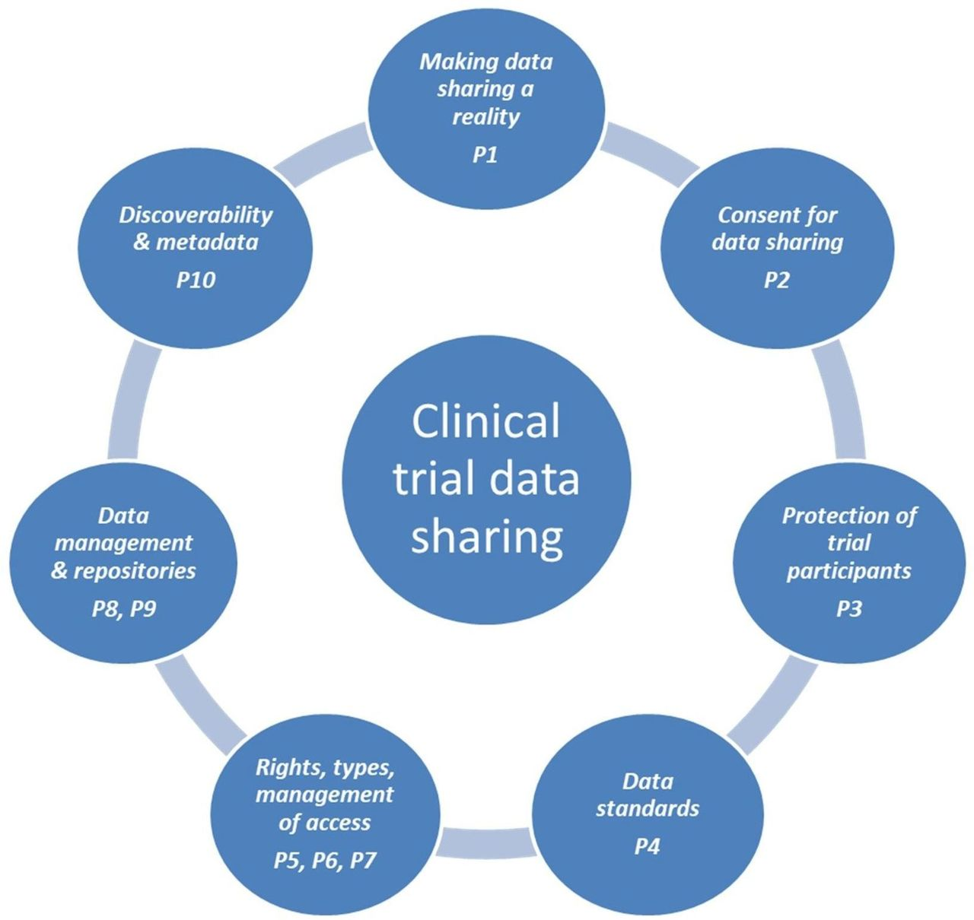
IPD Sharing
- Major aspects of sharing and reuse of data from clinical trials.
Christian Ohmann et al. BMJ Open 2017;7:e018647

Slide 6
Metadata – a lesson learned from librarians
Metadata is "data that provides information about other data", but not the content of the data.
Distinct types of metadata:
Descriptive metadata — the descriptive information about a resource. It is used for discovery and identification. It includes elements such as title, abstract, author, and keywords.
Structural metadata — metadata about containers of data and indicates how compound objects are put together, for example, how pages are ordered to form chapters.
It describes the types, versions, relationships and other characteristics of digital materials.
Administrative metadata — the information to help manage a resource, like resource type, permissions, and when and how it was created.
Reference metadata — the information about the contents and quality of statistical data.
Statistical metadata, also called process data, may describe processes that collect, process, or produce statistical data.
Legal metadata — provides information about the creator, copyright holder, and public licensing, if provided.
https://en.wikipedia.org/wiki/Metadata

Slide 7
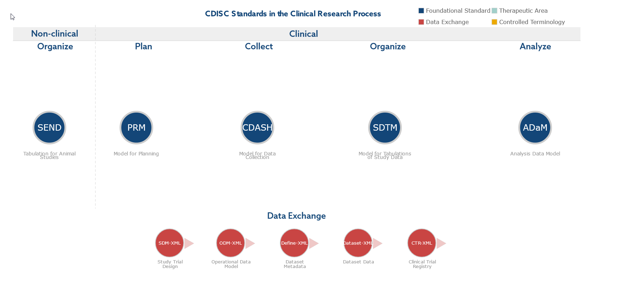
CDISC – a data processing framework oriented on IPD Sharing
Clinical Data Interchange Standards Consortium
ADaM defines dataset and metadata standards that support efficient generation, replication, and review of clinical trial statistical analyses, and traceability among analysis results, analysis data, and data represented in the Study Data Tabulation Model (SDTM).​
The US regulatory agency FDA has a large in-house statistics department that routinely re-analyses the data of pivotal trials. ADaM is one of the required standards for data submission to FDA (U.S.) and PMDA (Japan).

Slide 8
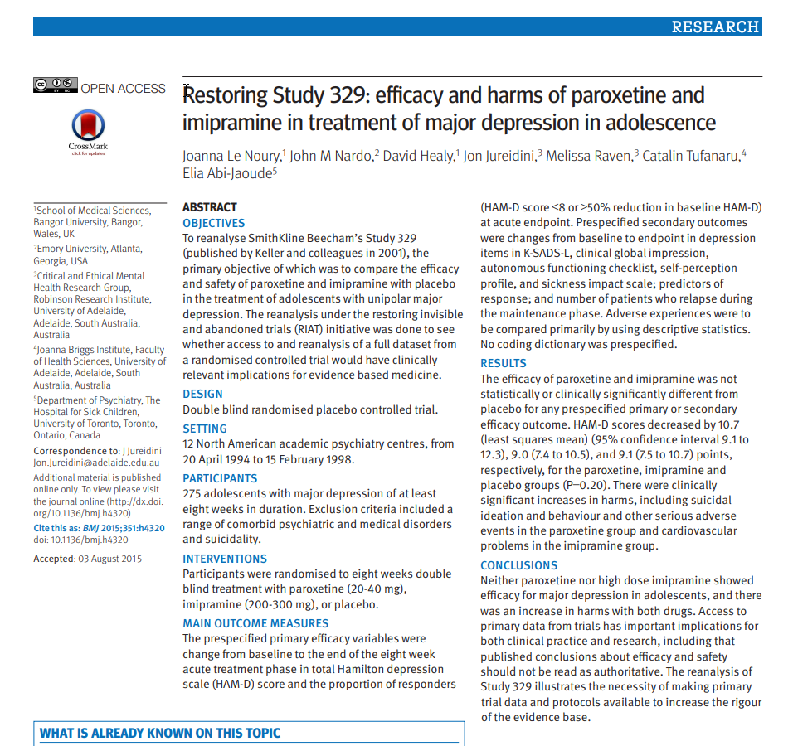
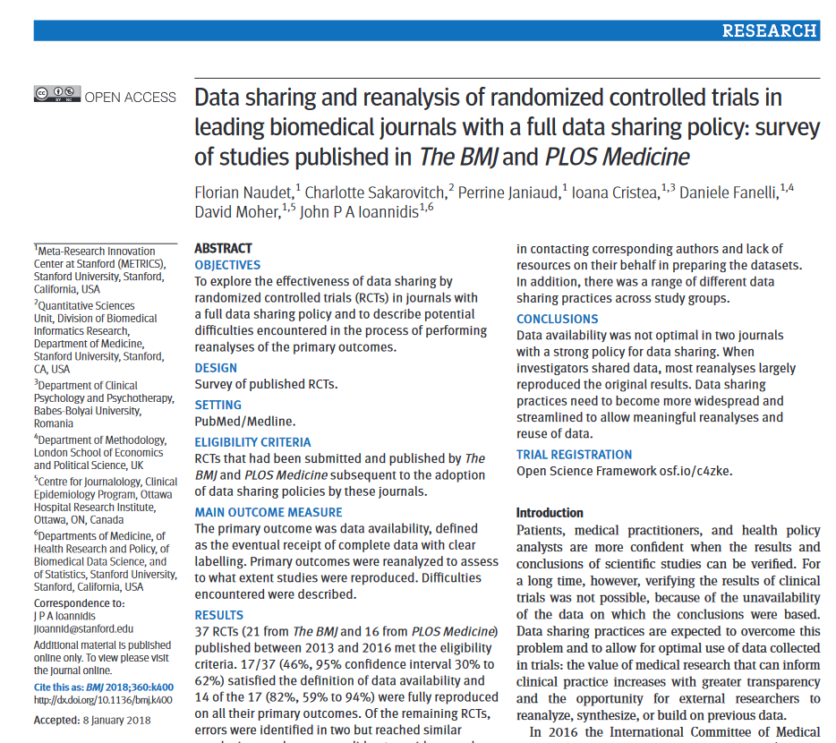
SDTM
ADaM
BMJ Open Data Campaign

Slide 9

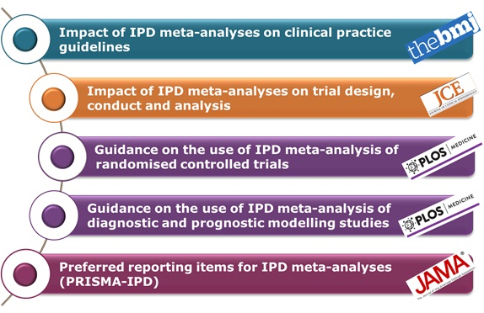
IPD Metaanalysis
https://methods.cochrane.org/news/individual-participant-data-meta-analysis-everything-you-always-wanted-know

Slide 10
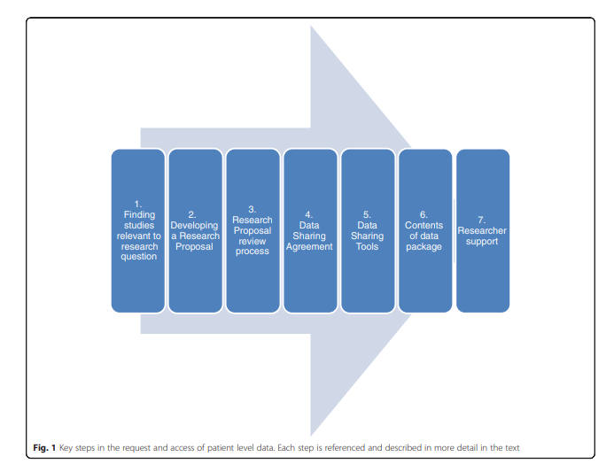
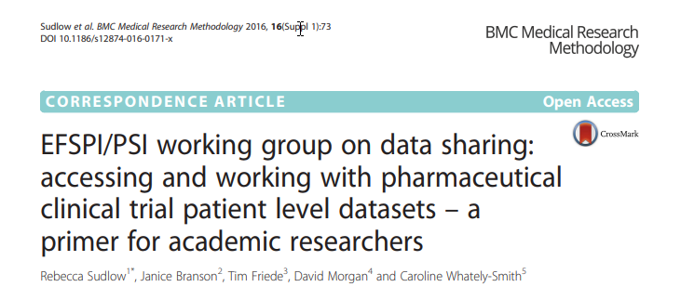
IPD Sharing – how to do it?

Slide 11
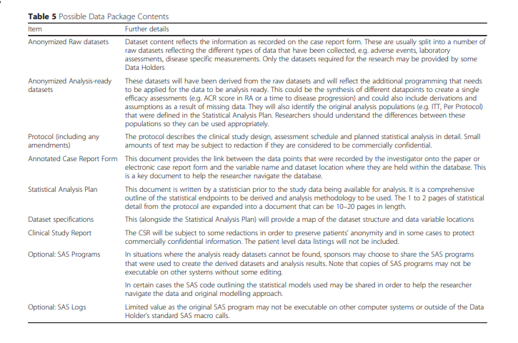
IPD Sharing – Pharma Standard

Slide 12
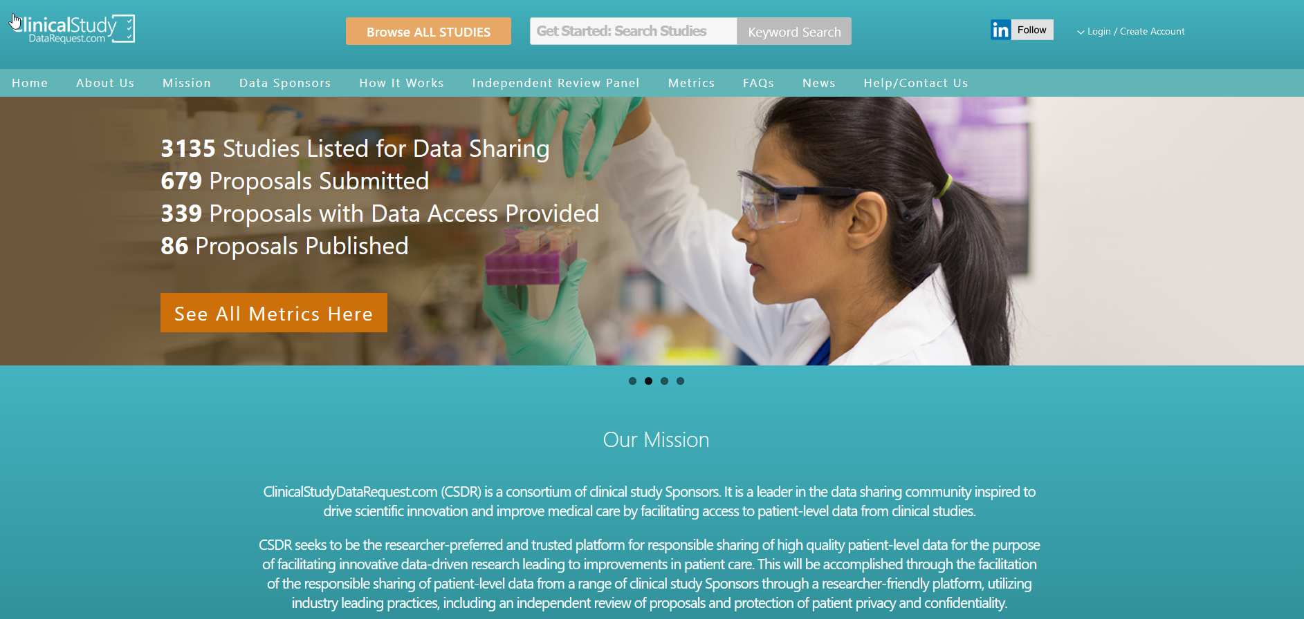
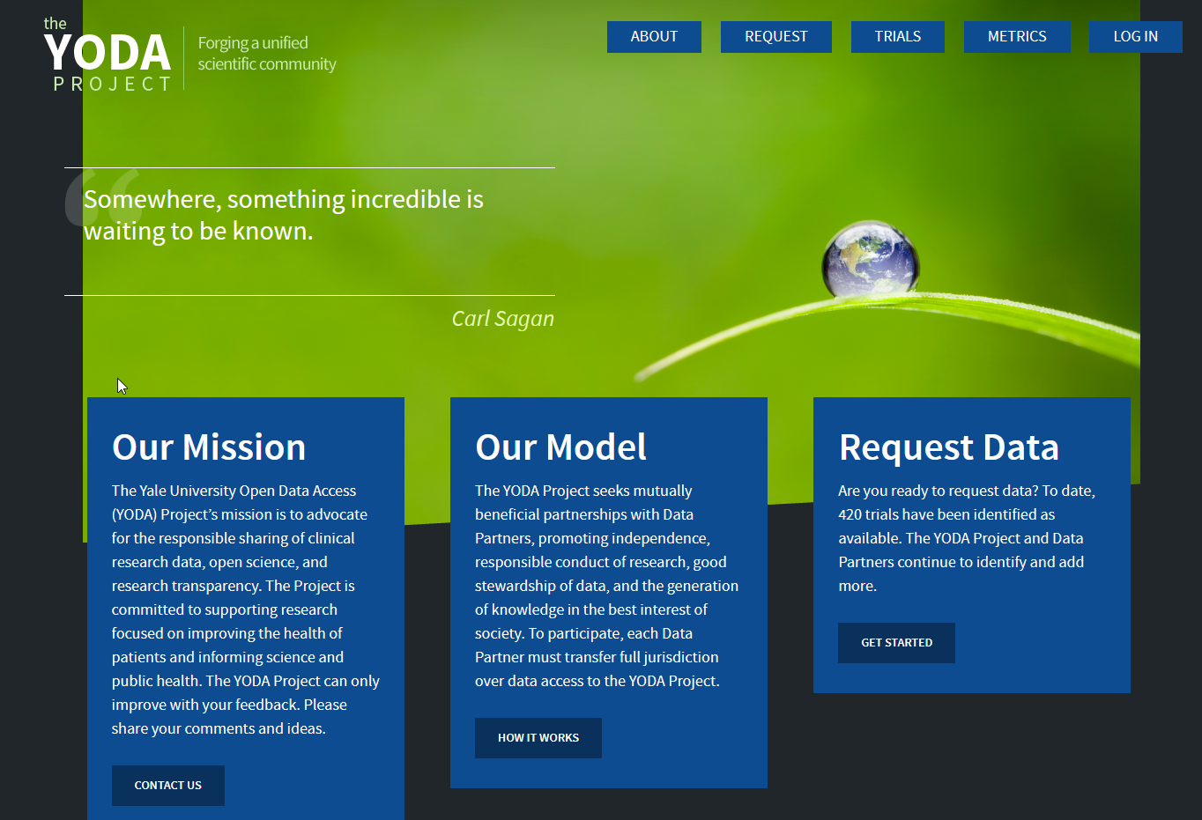

IPD Sharing Platforms
https://www.clinicalstudydatarequest.com/
https://yoda.yale.edu/
https://vivli.org/

Slide 13
IPD Sharing Platforms - is the juice worth the squeeze?
N Engl J Med 2016; 375:1608-1609
Data are not requested: Usage metrics from repositories such as YODA and CSDR suggest that a large majority of data is not requested or that re-uses may remain unpublished.
Practical issues: The process of data-sharing on these platforms is still cumbersome.
Quality: Many trials where data become available are small, or poorly designed studies presenting little interest for re-use of their data
Large, pivotal trials often fail to offer data-sharing.
Various data-sharing platforms are siloed, re-use is currently difficult to measure systematically, preventing the evaluation of its benefits.

Slide 14
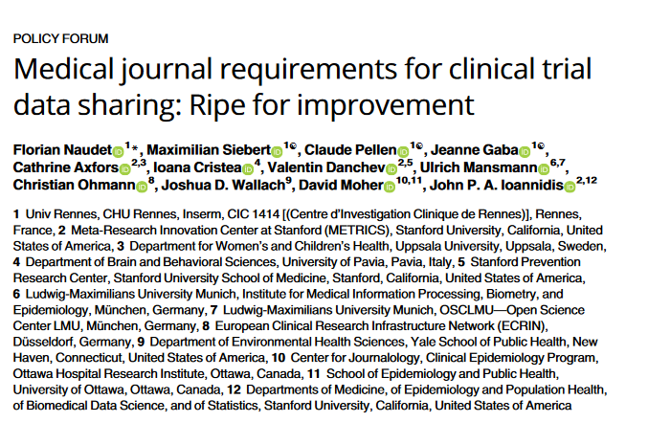
IPD Sharing – The academic experience

Slide 15
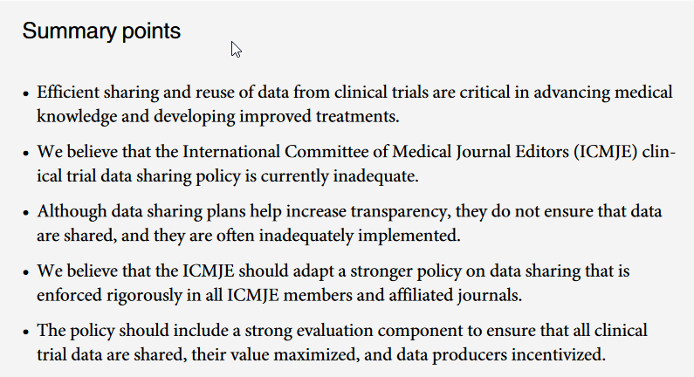
IPD Sharing – The academic experience

Slide 16
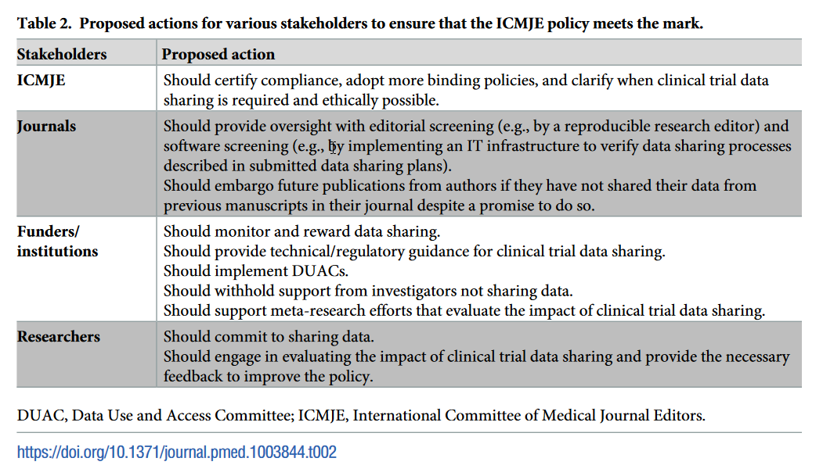
Data sharing – Actions needed

Slide 17
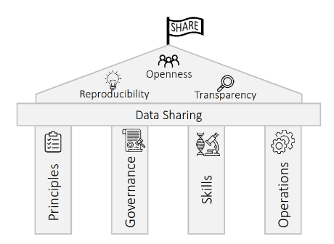
What needs to be done: SHARE-CTD
Fabian Prasser, Thierry Meurers

Slide 18
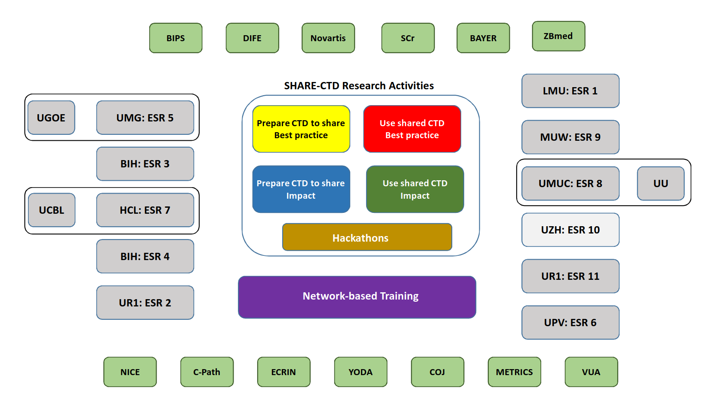
What needs to be done: SHARE-CTD

